Slide 1
Crowd Funding Data Insight
Werner Chao
March 26, 2017

Slide 2
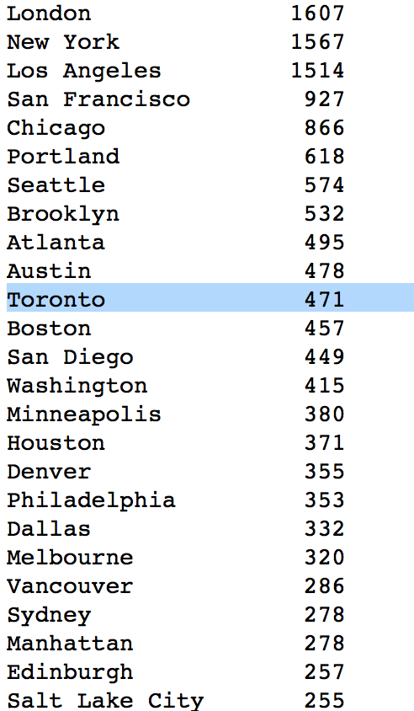
Where Does Toronto Stand in the World?
Number of campaigns in each city

Slide 3
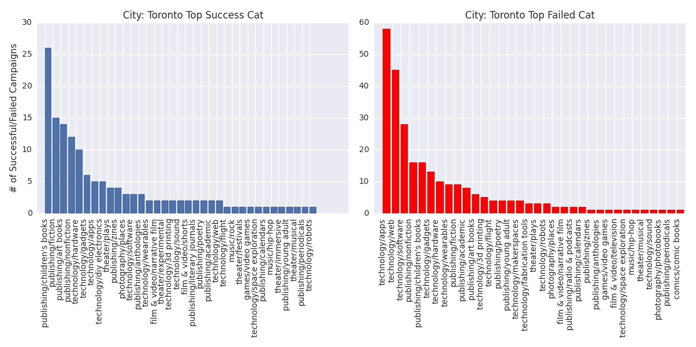
Toronto – Top 3 Most Successful Categories
Children’s Books
Hardware
Theater plays

Slide 4
Toronto – Top 3 Most Failed Categories
Apps
Web
Nonfiction books

Slide 5
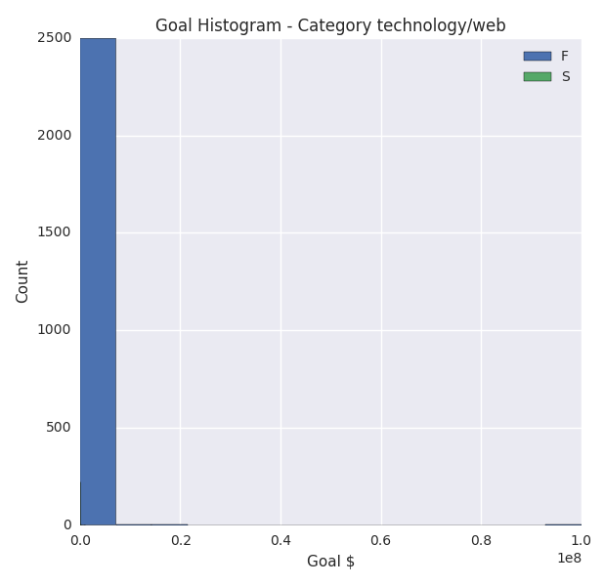
Miserable Category: Web - # of Failed campaigns: 2502 - # of Successful campaigns: 222 - Success Rate: 8%

Slide 6
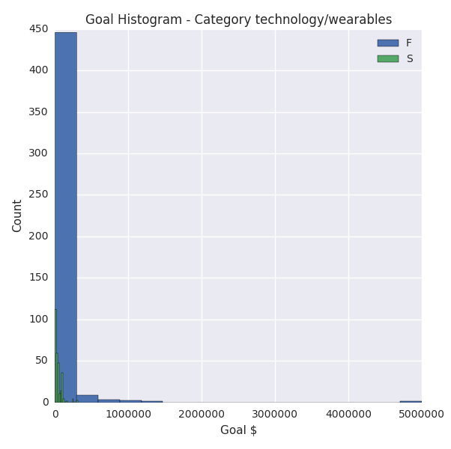
Good Category: Hardware - # of Failed campaigns: 1669 - # of Successful campaigns: 1078 - Success : 40%

Slide 7
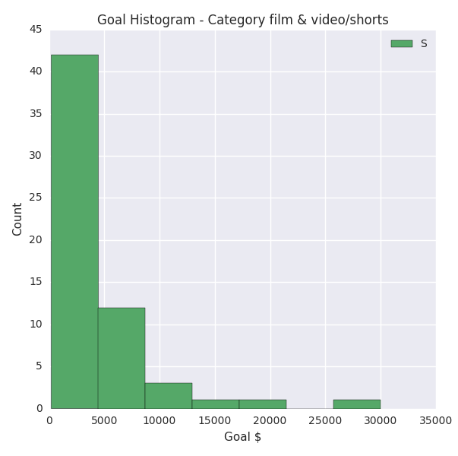
Good Category: Film & Short Videos - # of Failed campaigns: 0 - # of Successful campaigns: 60 - Success Rate: 100%

Slide 8
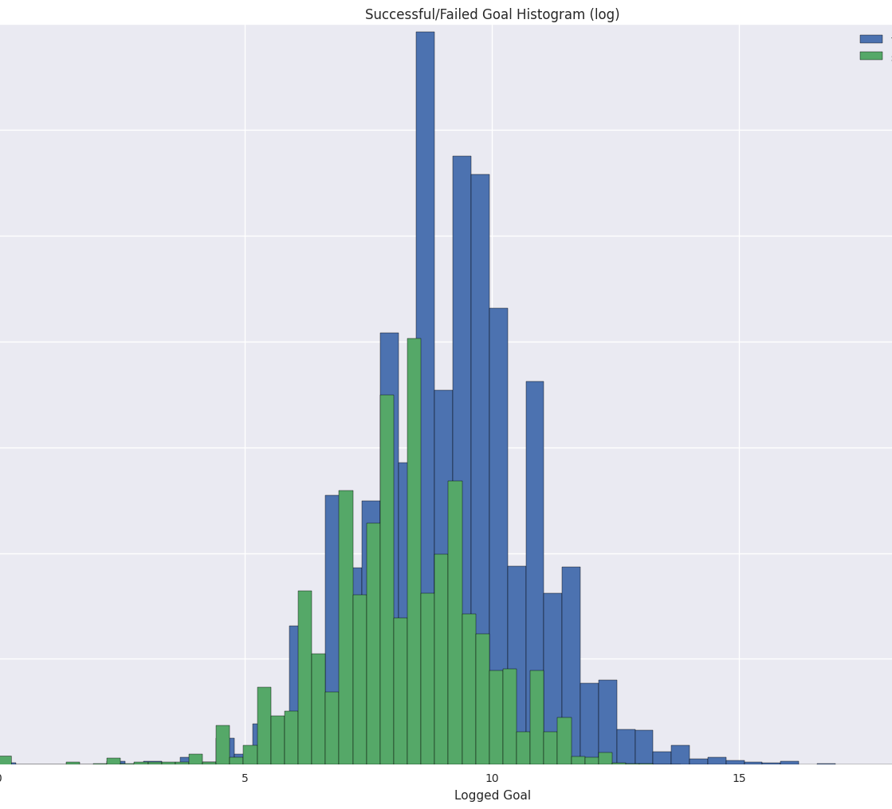
Success vs. Fail Goal
Failed goal usually aim too high

Slide 9
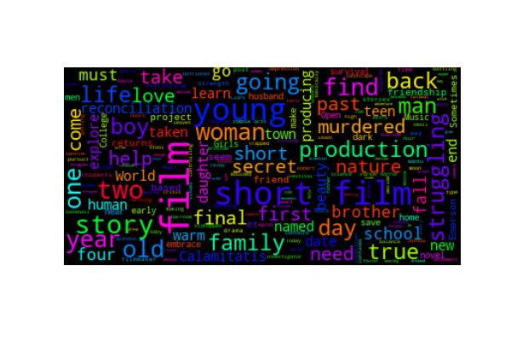
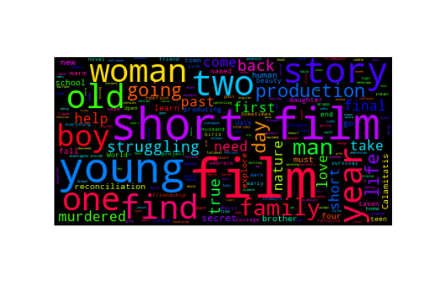
Buzz Words of – Short Films

Slide 10


Buzz Words of – Hardware

Slide 11
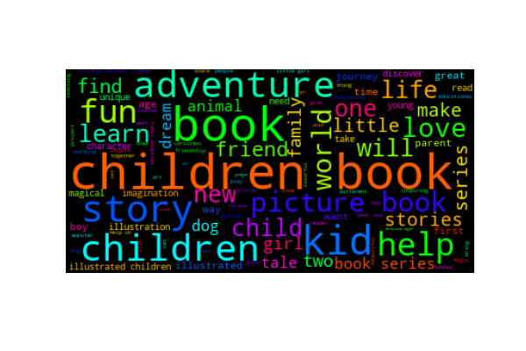
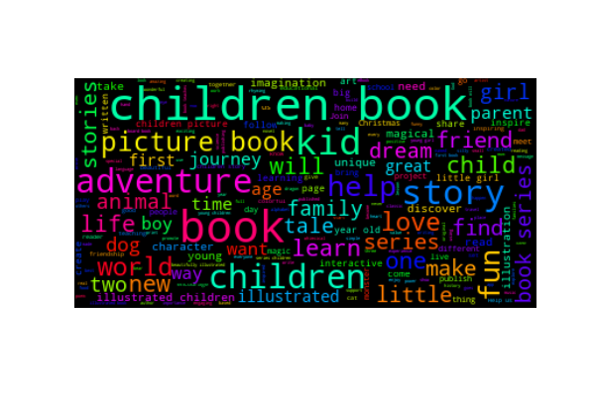
Buzz Words of – Children’s Books

Slide 12
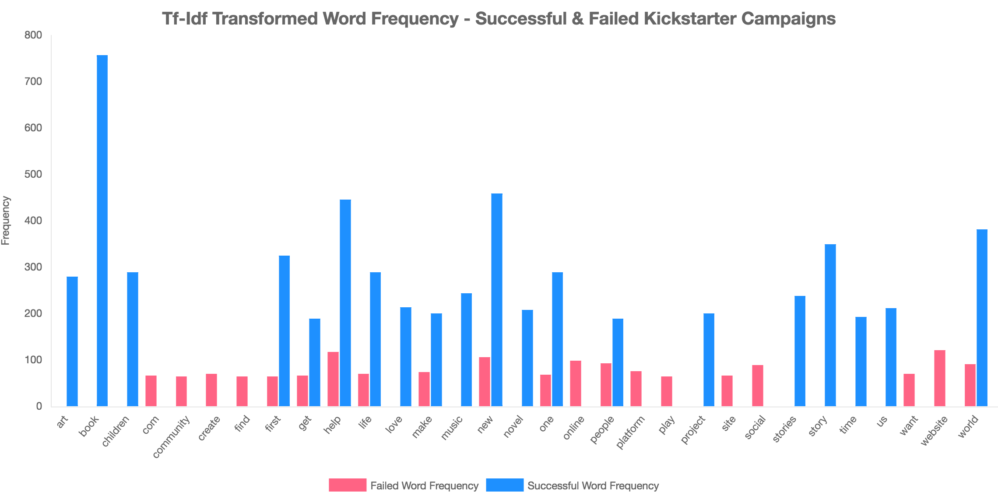
Most Frequent Words – All Categories

